Slide 1
Heat Transfer (CH21204)
Radiation Heat Transfer
Class –III

Slide 2
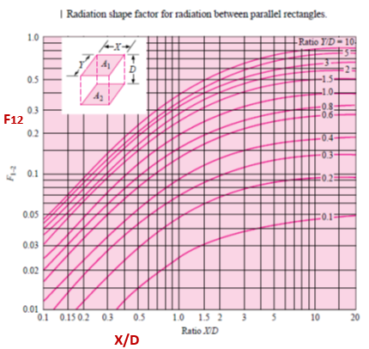


Slide 4
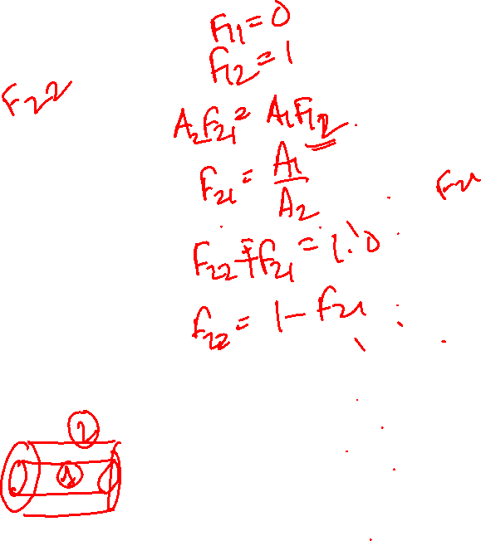
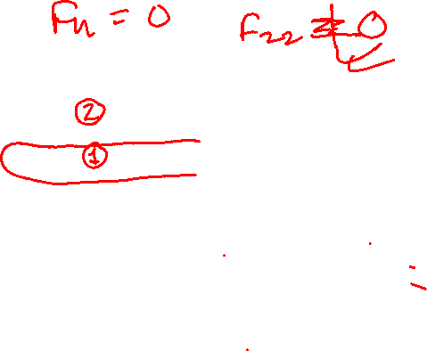

Slide 5
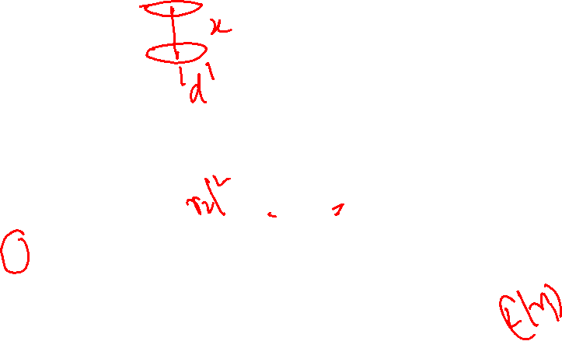

Slide 6
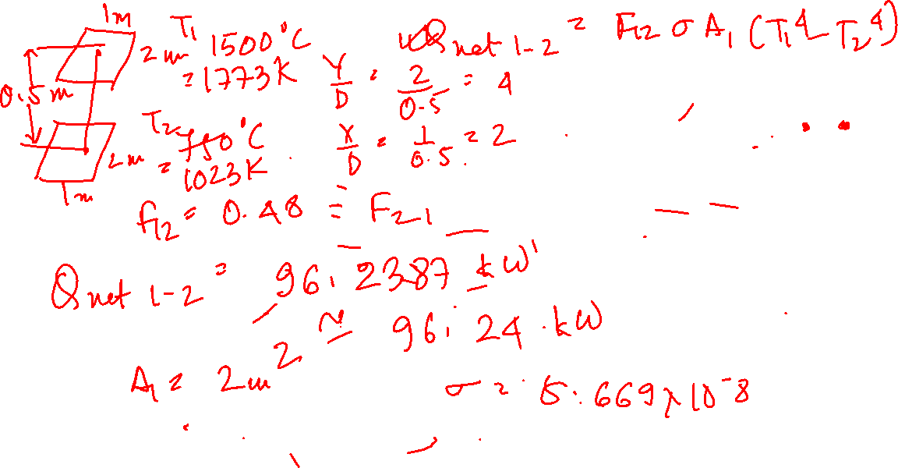
Example Problem
Two parallel black plates1.0 m by 2.0m are spaced 0.5 m apart. One plate is maintained at 1500C and the other at 750C. Estimate the net radiant heat exchange between the two plates.

Slide 7
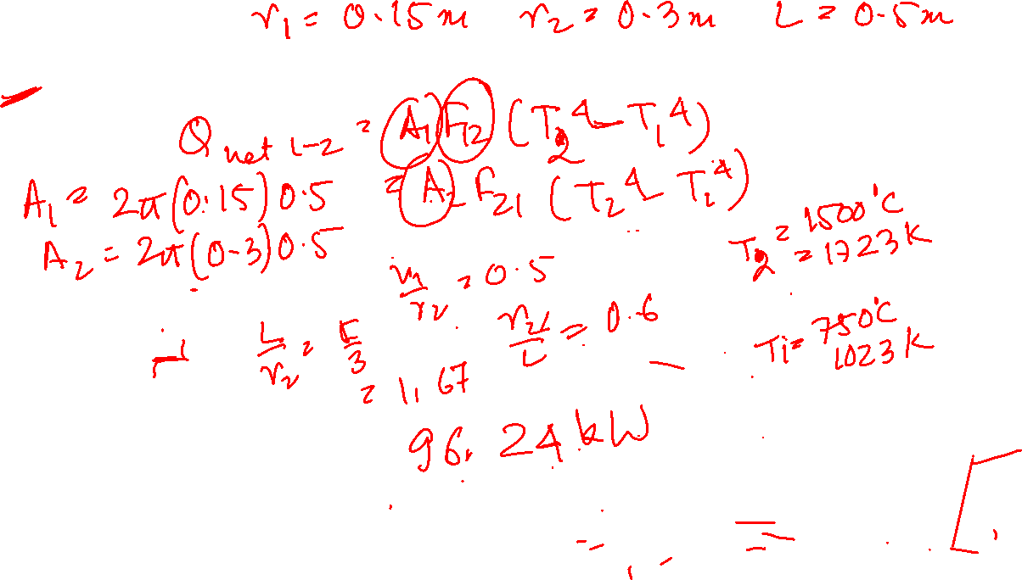
Example Problem
Two concentric cylinders of radius 15 cm and 30 cm have a length of 50 cm. If the outer cylinder is at 1500C and the inner at 750C, estimate the net radiant heat exchange between the two curved surfaces.

Slide 8
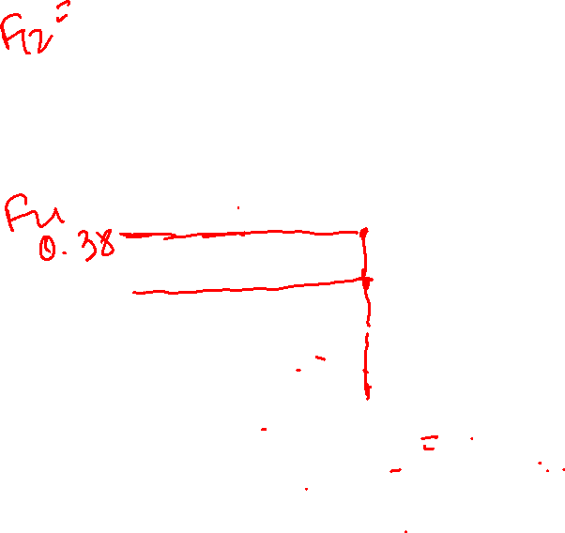

Slide 9
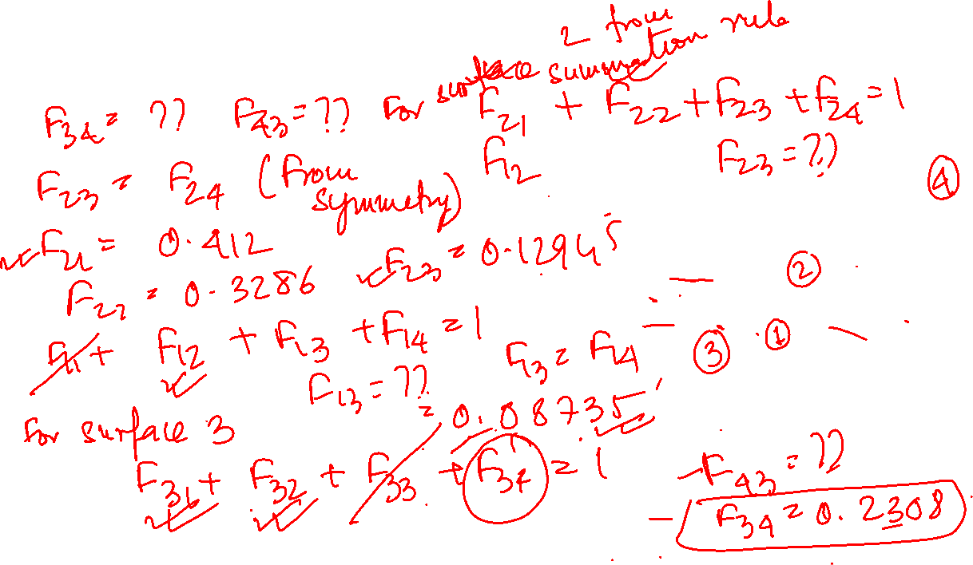
Example Problem
Two concentric cylinders of radius 15 cm and 30 cm have a length of 50 cm. Estimate the shape factor between the open ends of the cylinder.

Slide 10
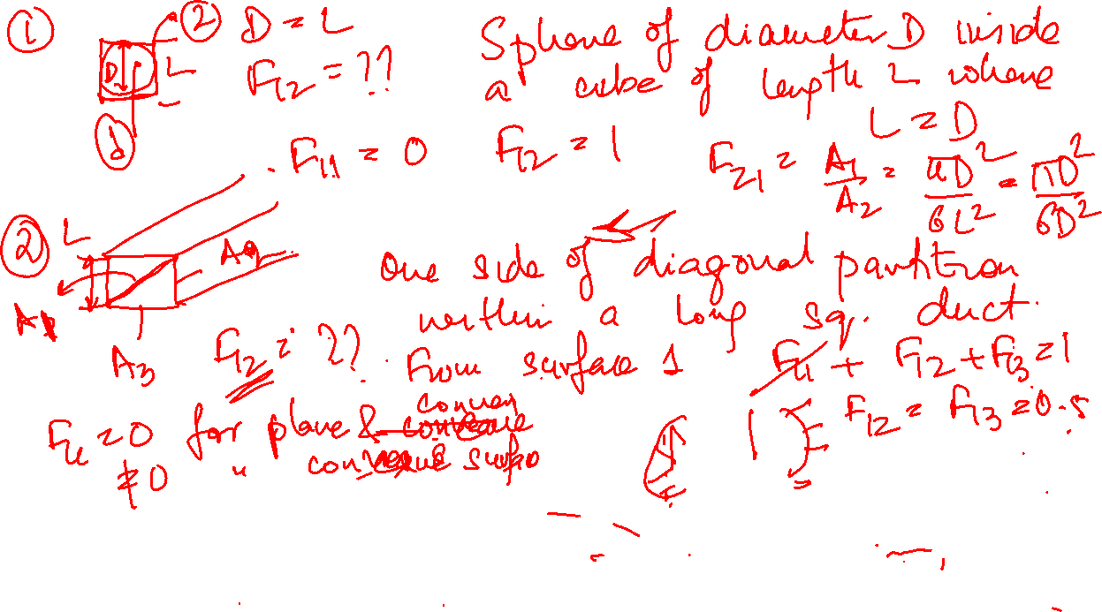

Slide 11
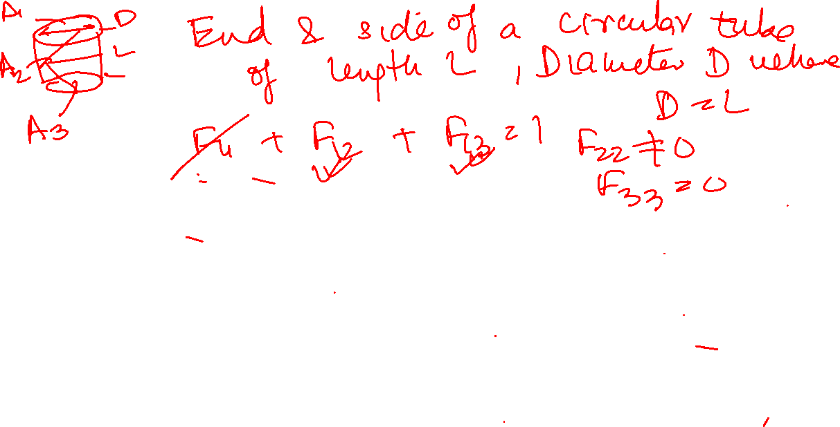

Slide 12
Black body radiation exchange
For an enclosure of N black surfaces maintained at temperatures T1, T2, … TN , net radiation transfer from any surface due to exchange with remaining surfaces

Slide 13
Sketch showing some relations between shape factors

Slide 14
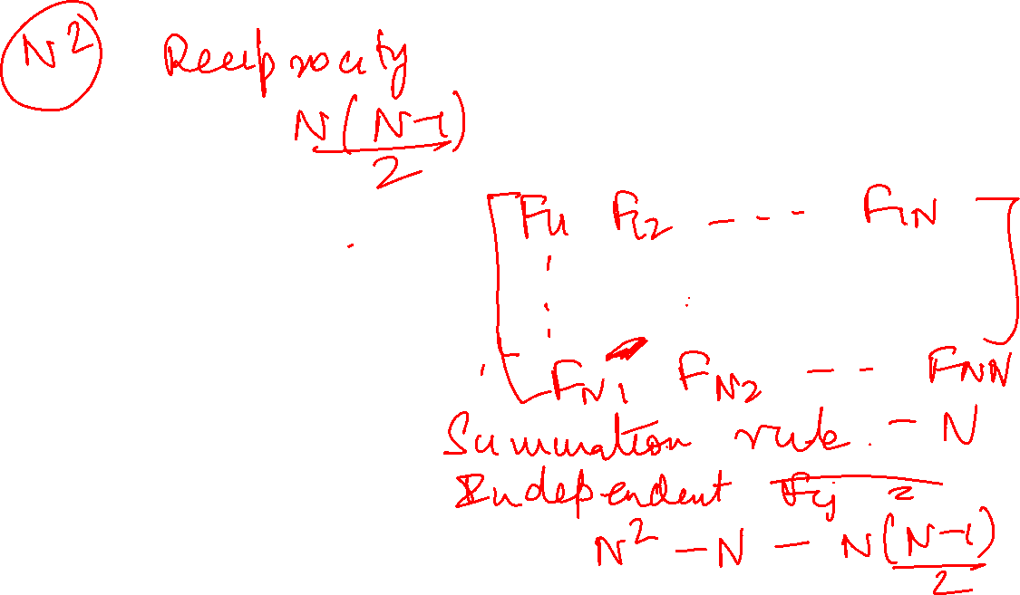
Relations between shape factors
Radiant Exchange in an enclosure

Slide 15
View factors for enclosures formed by two spheres

Slide 16
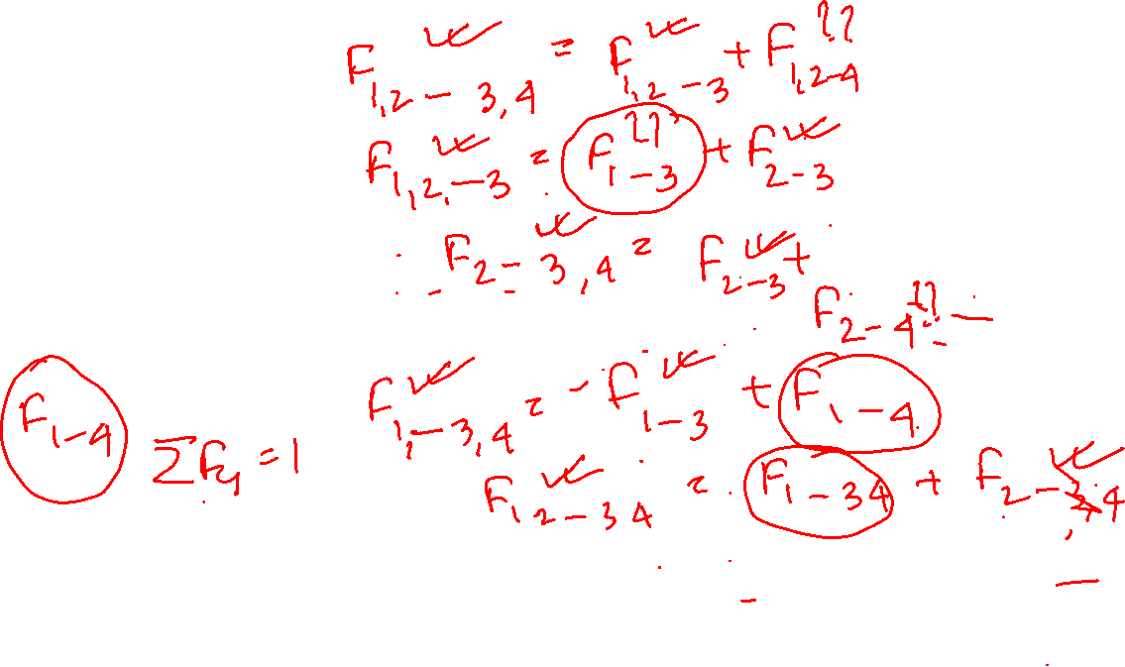
To find F14 from known shape factors

Slide 17
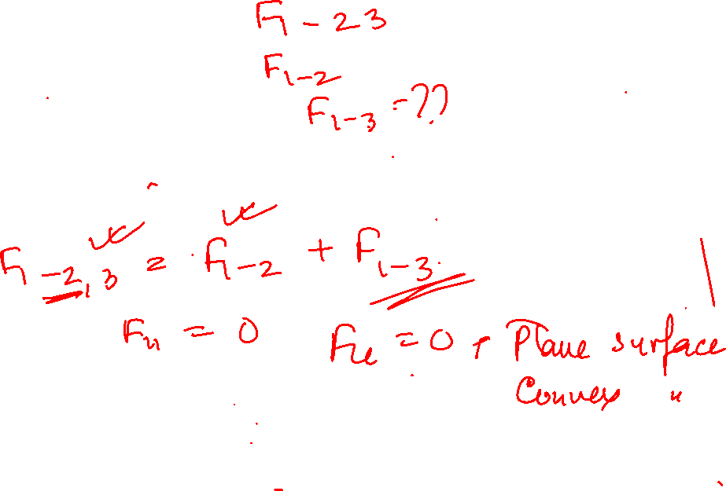
To find F13 from known shape factors

